Slide 2

Praveen Raghuvanshi
Principal Engineer, Harman International

Slide 3
Applying Data Science and Machine Learning Using Microsoft .Net
Praveen Raghuvanshi

Slide 4
Acknowledgements
Dataset – Cricsheet.org
Organizers – AzConf 2022
Sponsors
Participants

Slide 5
Wakeup
How many didn't like lunch?
How many are not .Net developers?
How many of you haven't tried their hands in data science and Machine learning?
How many of you haven't programmed in Python/R?
How many of you have been trying thier hands in DS and ML and struggling due to non .Net ecosystem?

Slide 6
Identify Language
Maidin mhaith
Guten Morgen
おはよ ございます
शुभ प्रभात
Good Morning

Slide 7



Programming Languages
Source: https://insights.dice.com/2019/10/24/tiobe-top-eight-top-ten-open/

Slide 8

Data Science – Exploratory Data Analysis(EDA)
As per Wiki…
“In statistics, exploratory data analysis (EDA) is an approach of analyzing data sets to summarize their main characteristics, often with visual methods.”
Buy a House
No of bedrooms
Type (Apartment, Villa)
Locality
Crime Rate
Source: https://insights.dice.com/2019/10/24/tiobe-top-eight-top-ten-open/

Slide 9
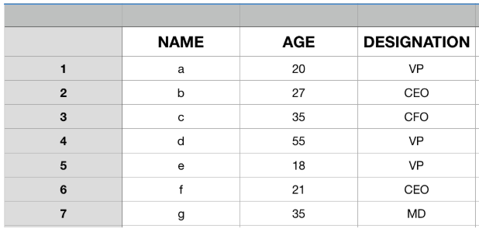
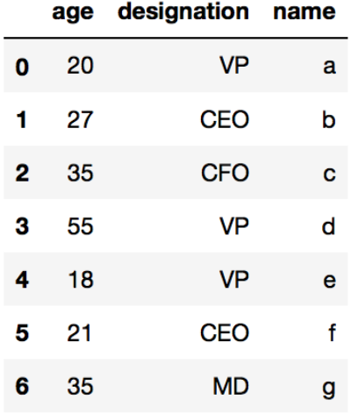
EDA Datastructure : DataFrame

Slide 10
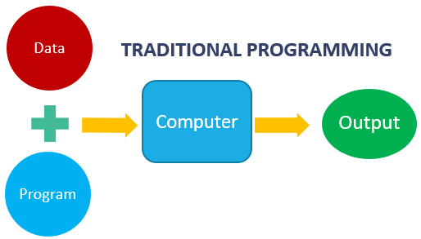
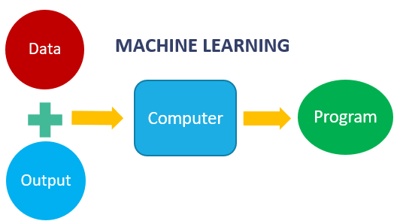
Machine Learning
Machine learning is getting computers to program themselves
If programming is automation, then machine learning is automating the process of automation

Slide 11
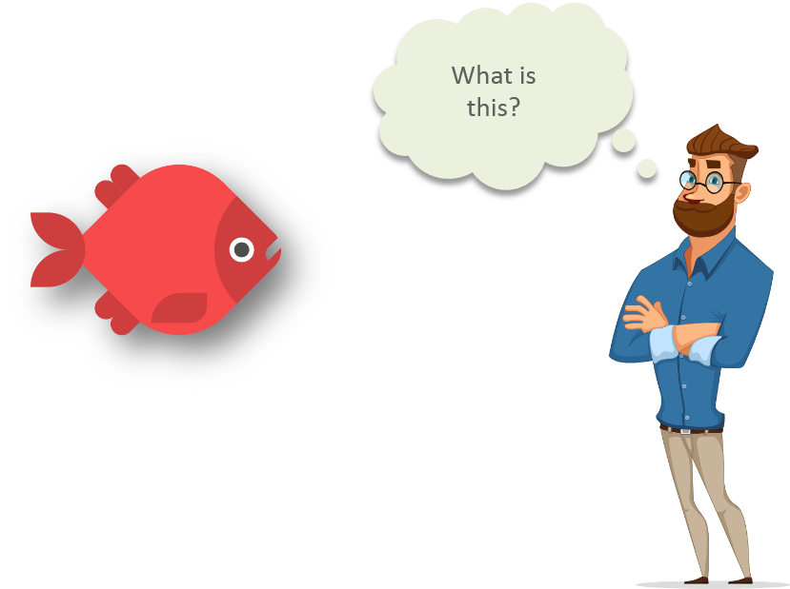
Machine Learning
source: https://www.quora.com/What-are-prerequisites-to-start-learning-machine-learning

Slide 12
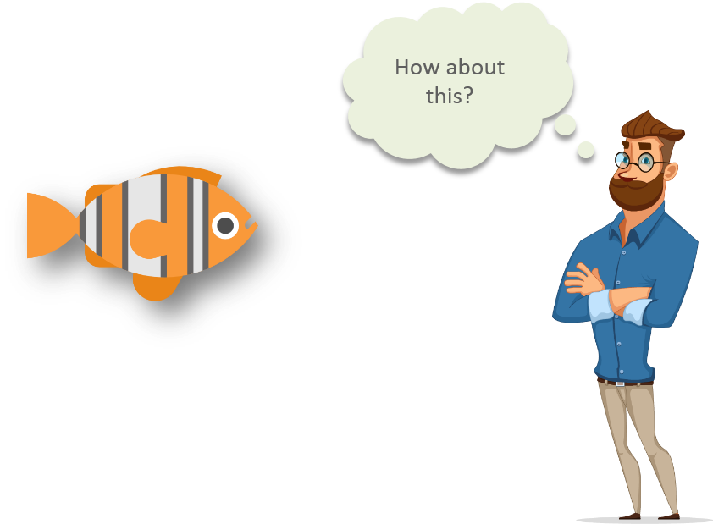
Machine Learning
source: https://www.quora.com/What-are-prerequisites-to-start-learning-machine-learning

Slide 13
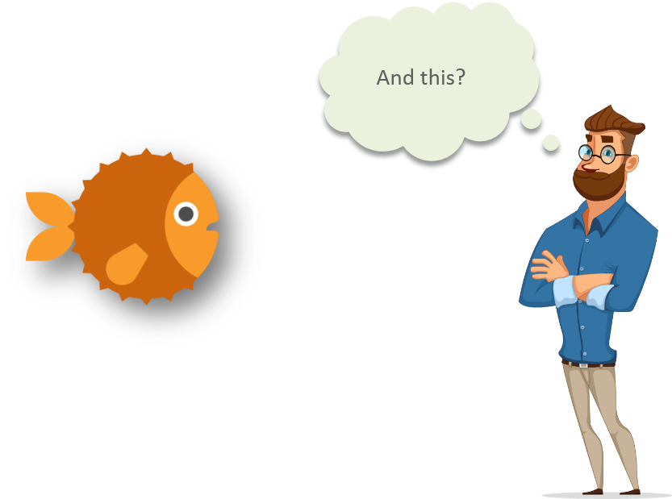
Machine Learning
source: https://www.quora.com/What-are-prerequisites-to-start-learning-machine-learning

Slide 14
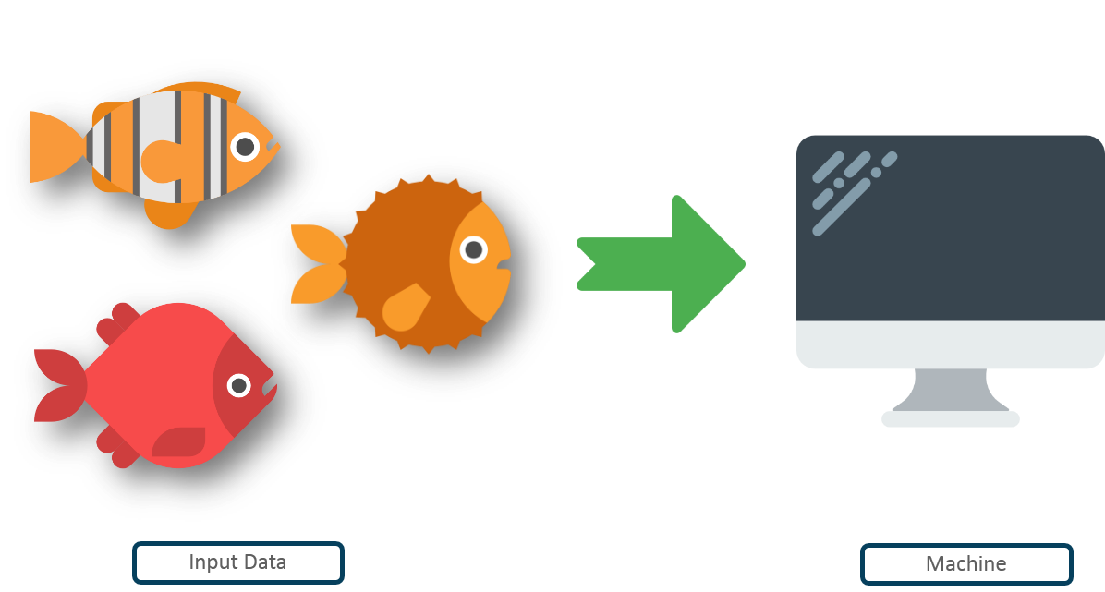
Machine Learning
Input data
Machine
Source: https://www.quora.com/What-are-prerequisites-to-start-learning-machine-learning

Slide 15
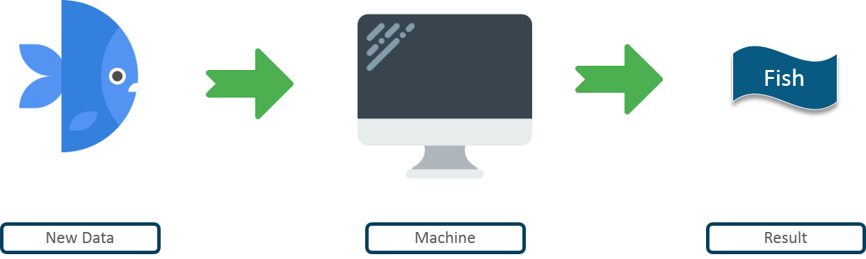
Machine Learning
New Data
Machine
Result
Source: https://www.quora.com/What-are-prerequisites-to-start-learning-machine-learning

Slide 16
Pre-Requisites of ML
A Pattern should exist
Mathematical model/algorithm is unknown
Abundant data

Slide 17
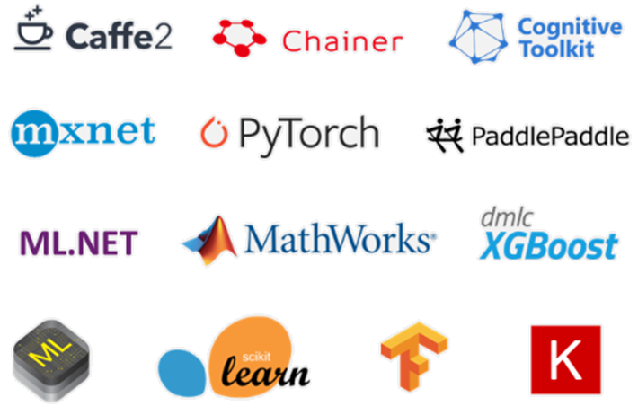
ML Frameworks

Slide 18

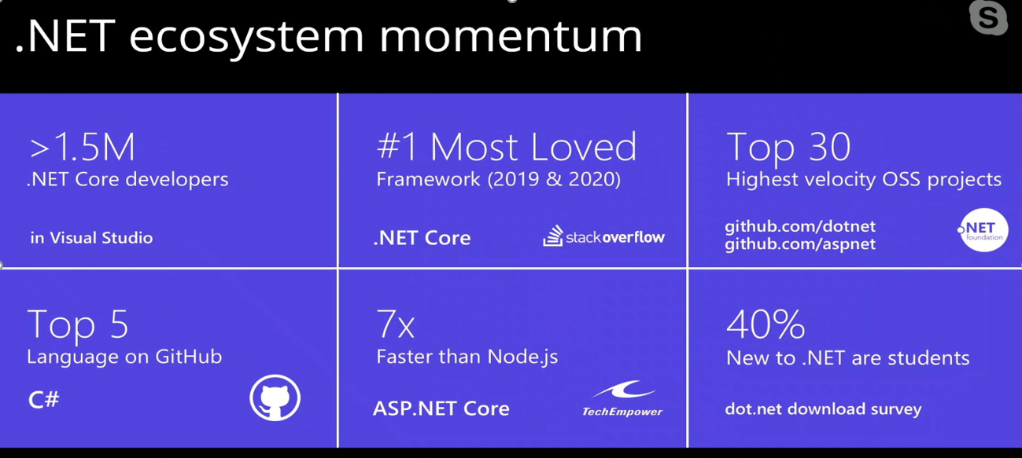
Why ?

Slide 19
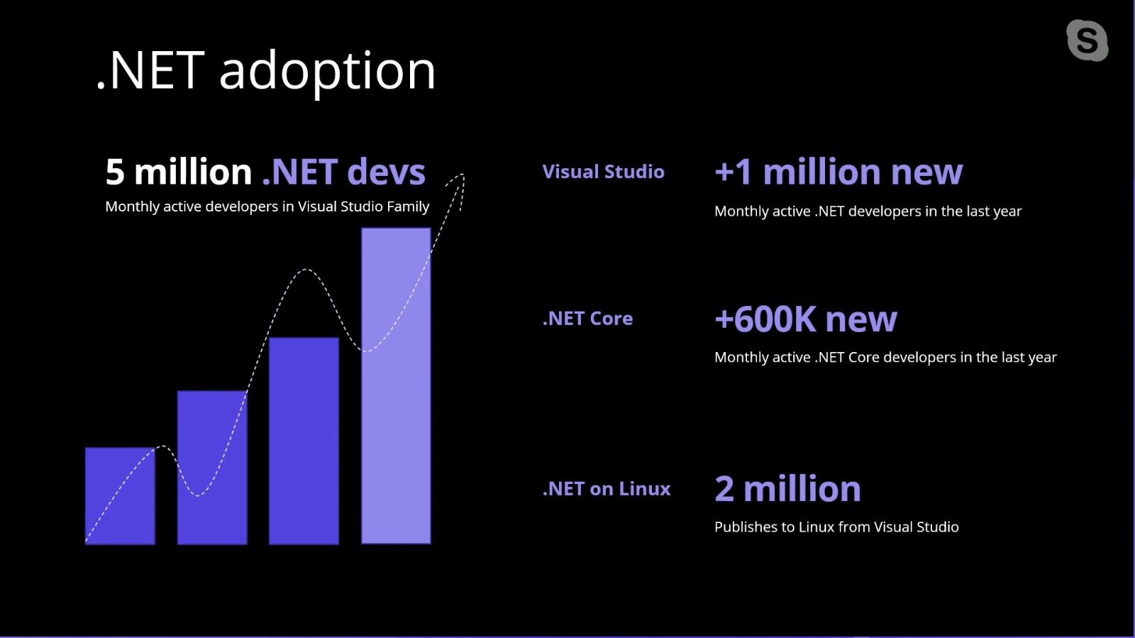
Why ?

Slide 20
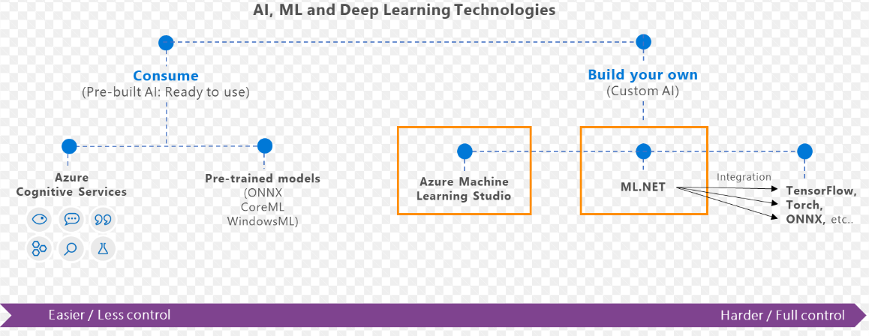
What is ML.Net ?
ML Framework from Microsoft for developing custom AI/ML applications.
Originated in 2002 as part of Microsoft Research Project

Slide 21
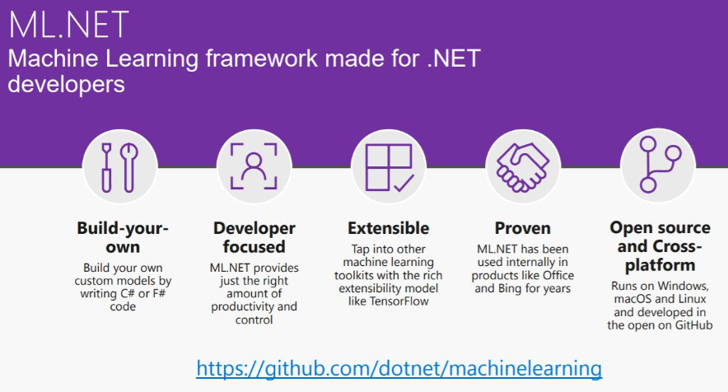
What is ML.Net ?

Slide 22
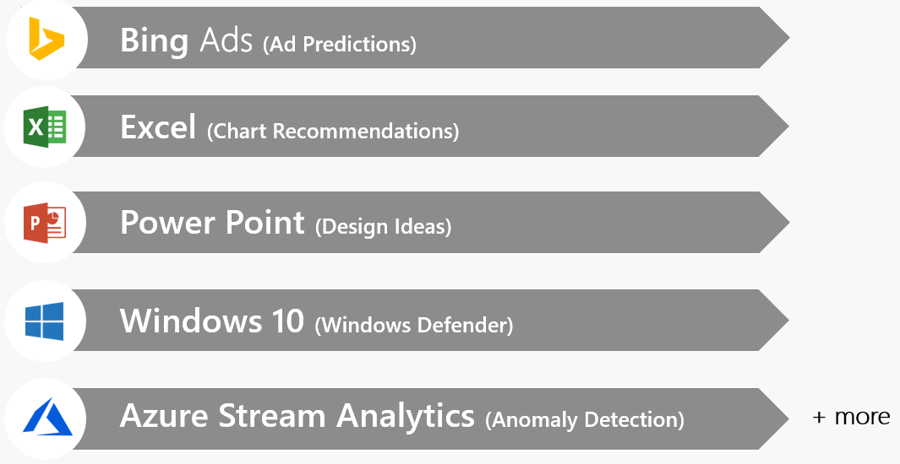
ML.Net – Proven at Scale, Enterprise ready

Slide 23
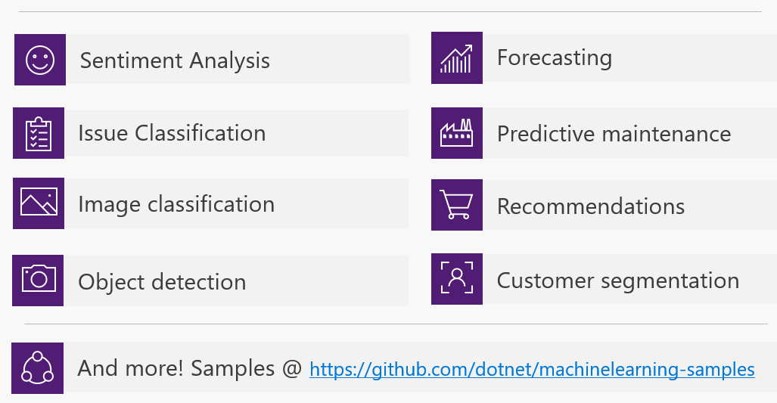
ML.Net – Possibilities

Slide 24
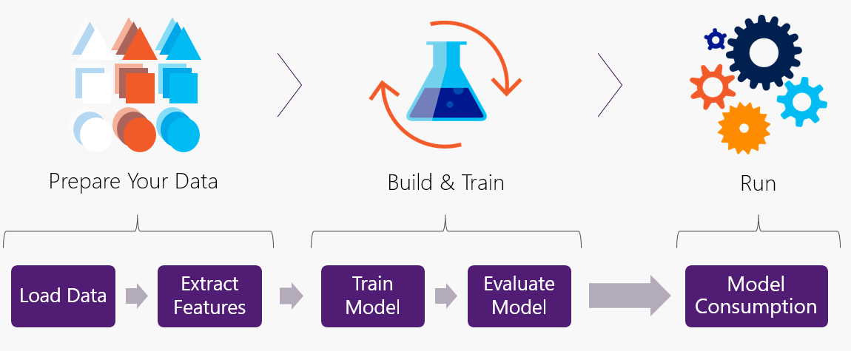
ML.Net – Workflow

Slide 25
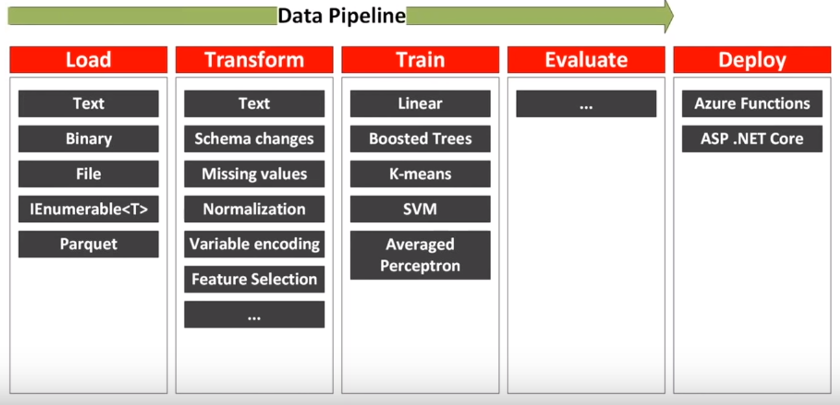
ML.Net – Data Pipeline

Slide 26
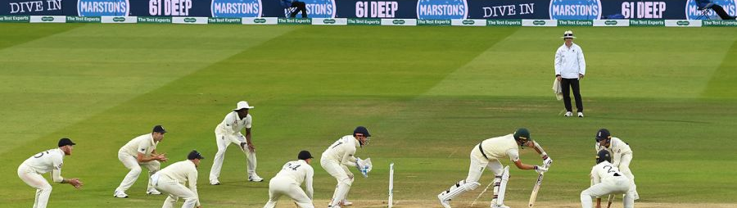
Cricket – EDA and Prediction
Statistics(2019-2020)
Played by 104 Nations
IPL Valuation: $6.7 billion
IPL Viewers : 370 Million

Slide 27






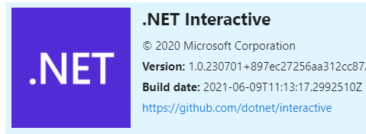
Tools and Frameworks

Slide 28
Cricket : Problem Statement
Perform analysis on cricket dataset
Predict score on a specific ball within 6 overs

Slide 29
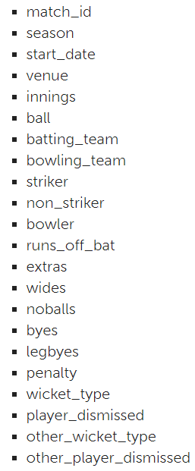
Dataset
T20 Match - Men
Duration: 2017 – 2021
Matches : 1010
Teams: 56
Columns: 22
Records: 231 K
Mix of number and strings

Slide 30
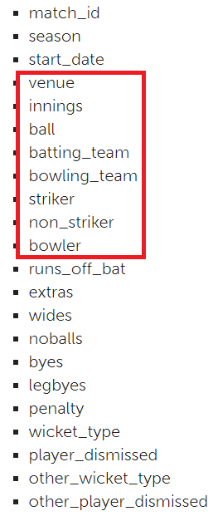
Data Cleaning
Filter dataset to include records till 6 over. Low memory and fast execution
Check for Null Values
Aggregation : Score per ball → runs_off_bat + extras
Cumulative sum : Total Score per ball
Remove features/columns

Slide 31
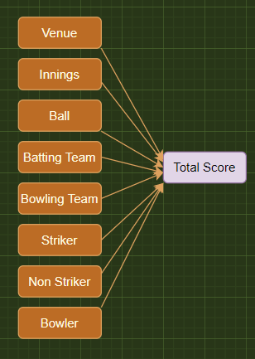
Prediction
Regression using ML.Net
Define Classes : Match, MatchScorePrediction
Load Dataset
Split Dataset: Train/Test : 80/20
One Hot Encoding
Model Algorithm : FastTree
Train → Evaluate → Predict the Model

Slide 32
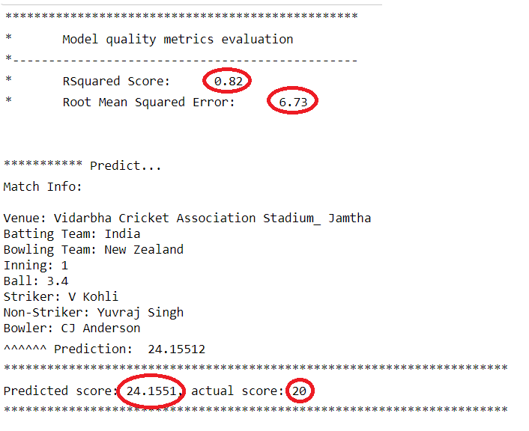
ML.Net – API (Jupyter Notebook)

Slide 33
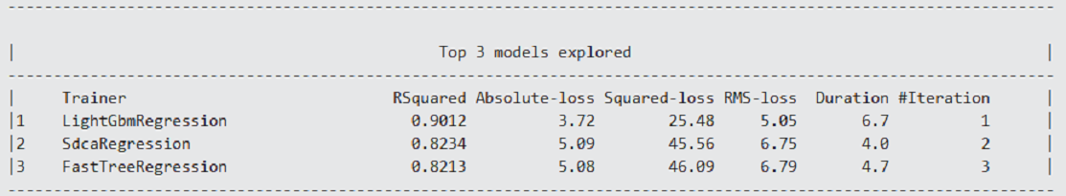
ML.Net – AutoML (Model Builder)

Slide 34
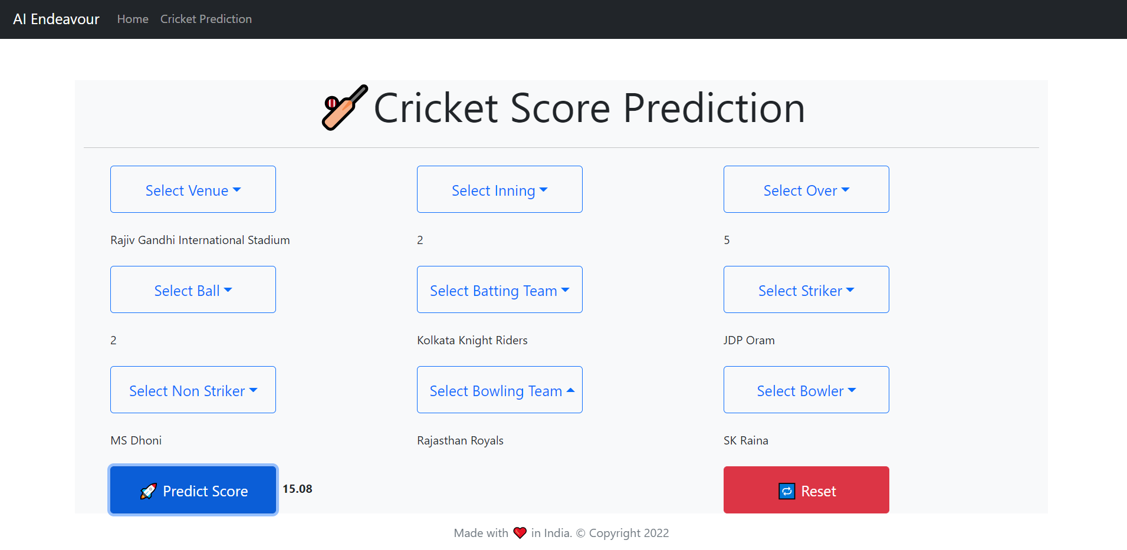
ML.Net – Web App

Slide 35
Demo

Slide 36
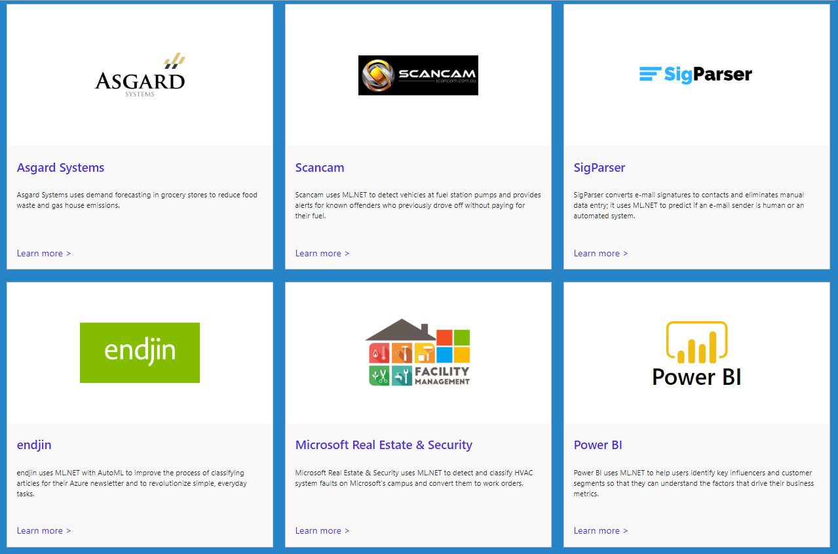
ML.Net : Customer Stories
https://dotnet.microsoft.com/apps/machinelearning-ai/ml-dotnet/customers

Slide 37
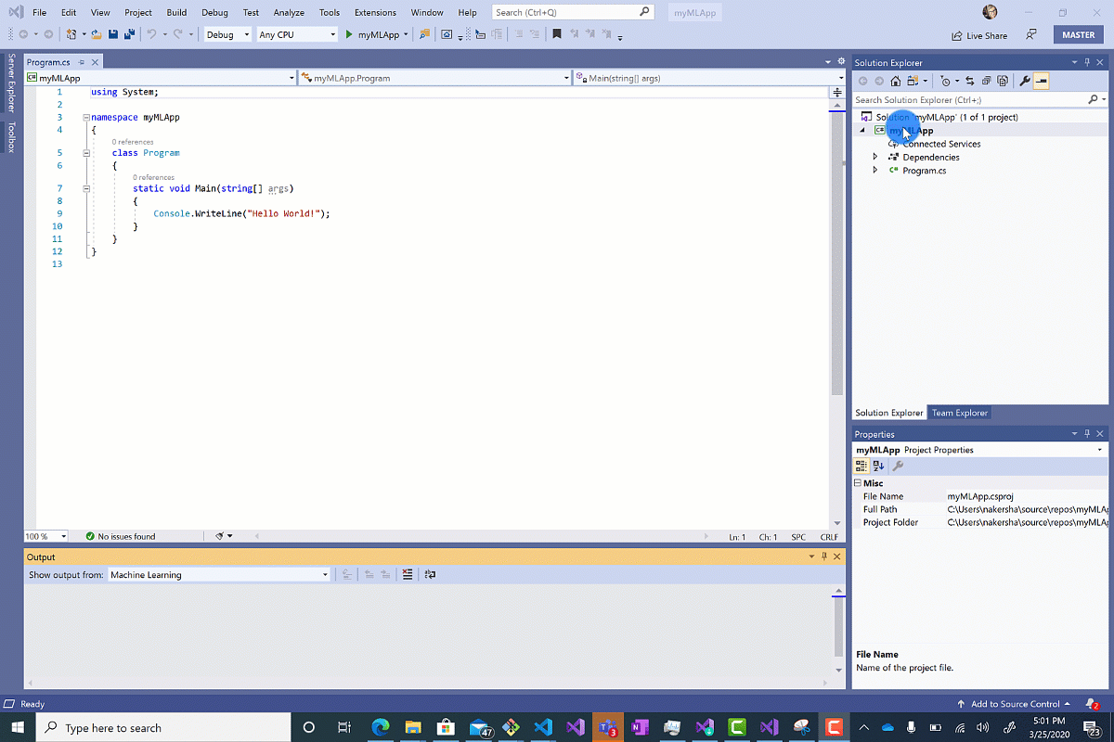
ML.Net : Model Builder(AutoML)

Slide 38
References
ML.Net : https://dotnet.microsoft.com/apps/machinelearning-ai/ml-dotnet
ML.Net: https://devblogs.microsoft.com/cesardelatorre/what-is-ml-net-1-0-machine-learning-for-net/
ONNX : https://onnx.ai/
Photo-Search (ONNX) : https://github.com/Tak-Au/Photo-Search
Music Repair : https://www.youtube.com/watch?v=nnV-1q-z9uE
ML Cookbook : https://github.com/dotnet/machinelearning/blob/master/docs/code/MlNetCookBook.md
Deploy to Azure functions : http://luisquintanilla.me/2018/08/21/serverless-machine-learning-mlnet-azure-functions/
https://rubikscode.net/2019/02/18/ultimate-guide-to-machine-learning-with-ml-net/
https://www.youtube.com/watch?v=dojO4zEL9sg
https://www.youtube.com/watch?v=zy7Y9CHji2k
https://dotnet.microsoft.com/apps/machinelearning-ai/ml-dotnet/customers

Slide 39

Resource
Github: https://github.com/praveenraghuvanshi/tech-sessions/tree/master/21102022-AI-ML-using-ml-dotnet-azconf-2022
Dev.to : Cricket Analysis and Prediction using ML.Net(C#) - DEV Community 👩‍💻👨‍💻
Short Url: https://bit.ly/3MH34hv

Slide 40






Platinum Partner
Gold Partner
Silver Partner

Slide 41
Q & A

Slide 42
Applying Data Science and Machine Learning using Microsoft .Net
Praveen Raghuvanshi
@praveenraghuvan

